Slide 1

WAY TO ENTERPRISE
Java Basics
VTI ACADEMY
Author: duy.nguyenngoc1@vti.com.vn
March 2020

Slide 2
Agenda
OOP
Assignments
Copyright © VTI Academy All Rights Reserved

Slide 3
Abstraction
Abstract class
Interface

Slide 4
Interface
Is not object
Method of interface is public abstract method

Slide 5
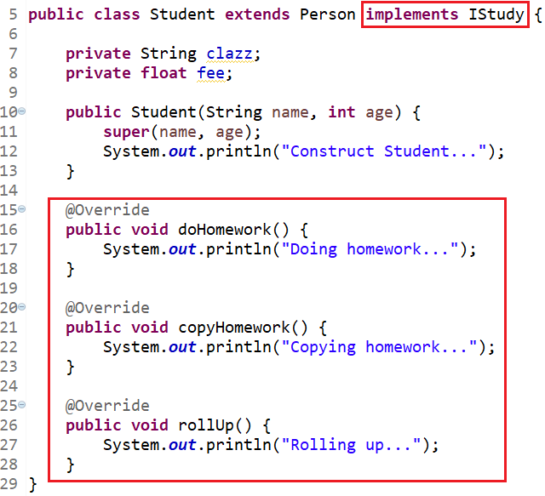
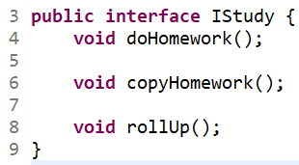
Example

Slide 6

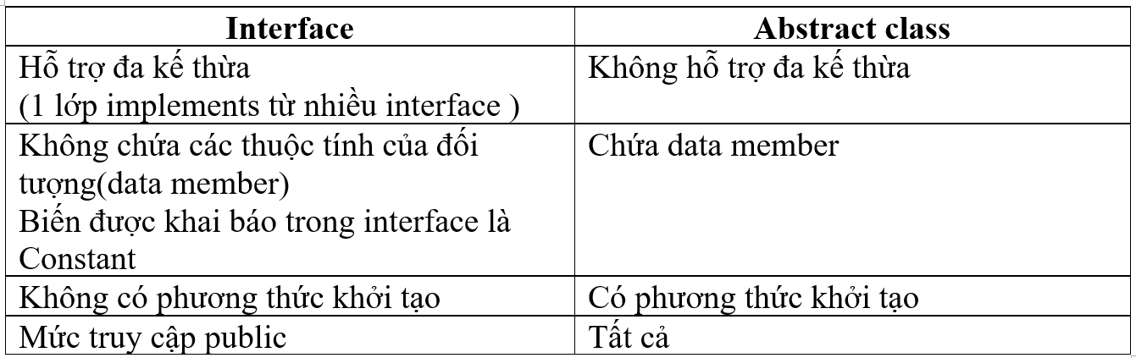
Abstract and interface
Variable in interface is constant
Method in interface is public abstract

Slide 7
Polymorphism
Object Management (Manage Parent, Not manage child)
Keyword instanceof
Override và Overload

Slide 8
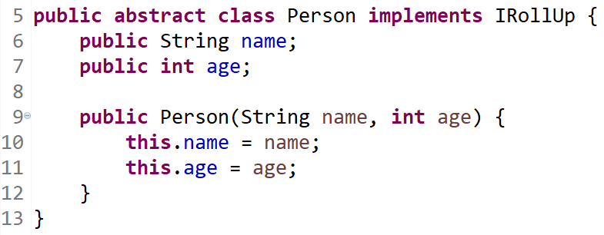
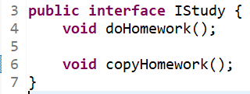

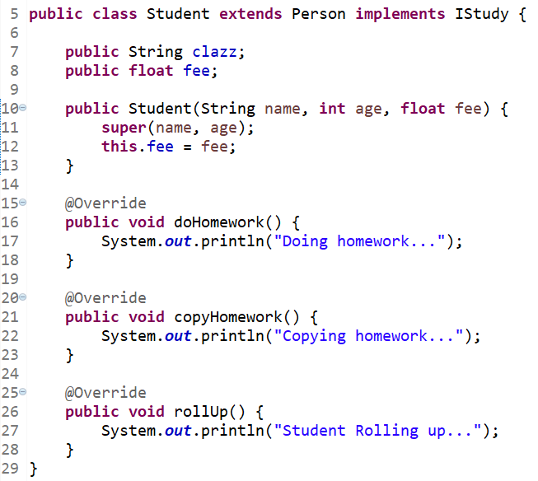
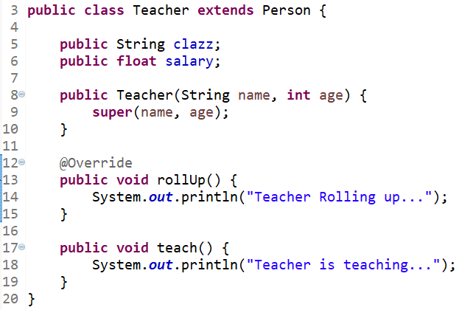
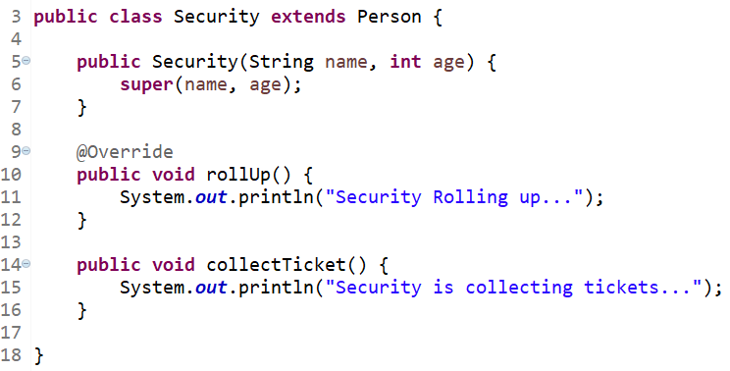
Object Management

Slide 9
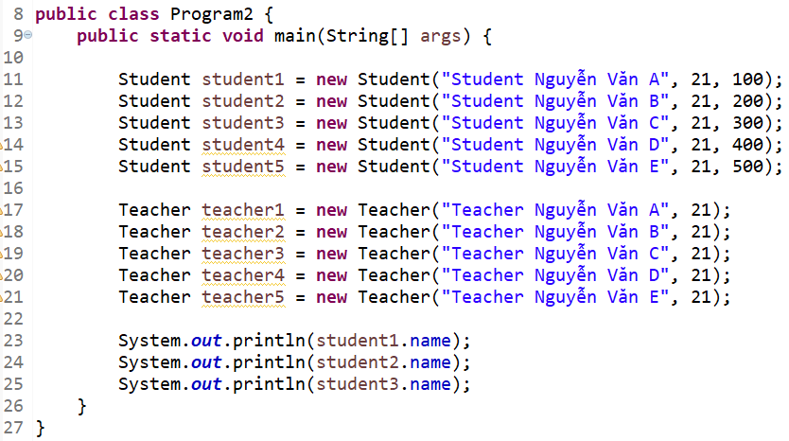
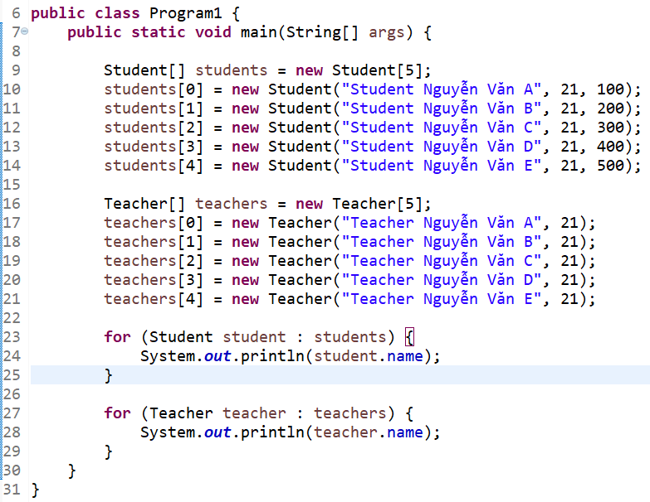
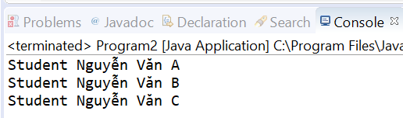
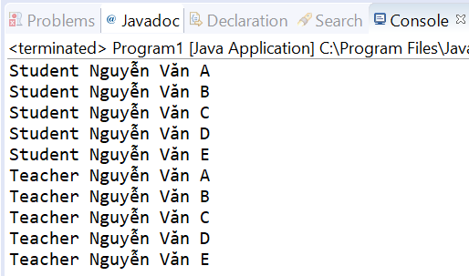
Object Management (Array)

Slide 10
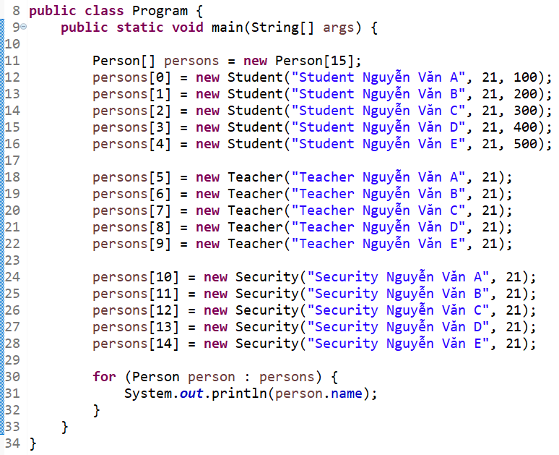

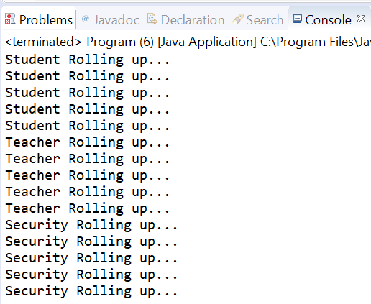
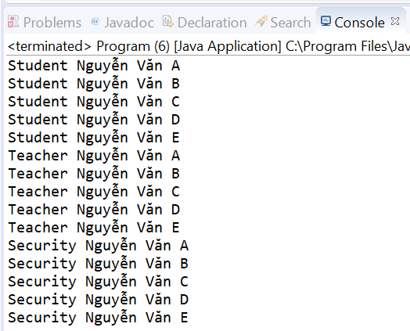
Object Management (Polymorphism- Common Property, method)

Slide 11
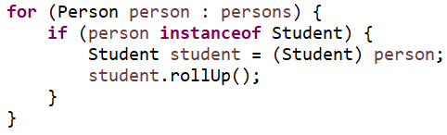
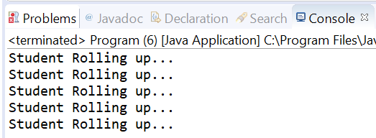
Object Management (Polymorphism- Child’s Property, method)

Slide 12
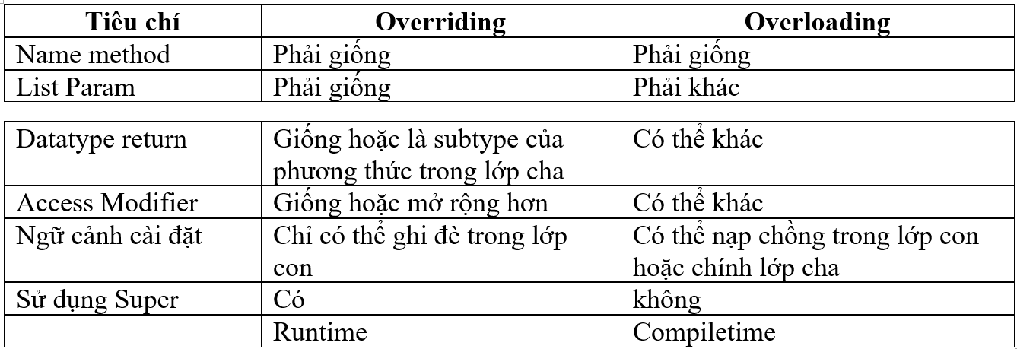
Override và Overload

Slide 13
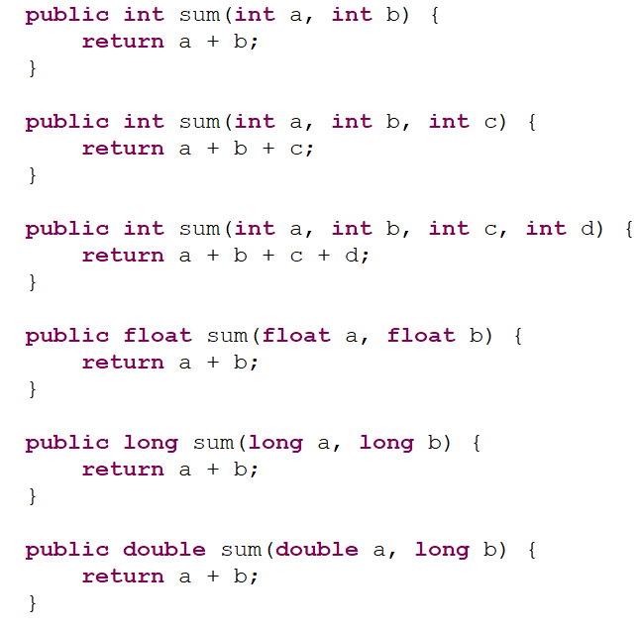
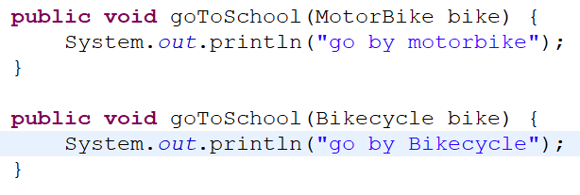
Overloading Example

Slide 14
This & super

Slide 15
Assignments 1

Slide 16
Assignments 2
Assignment for Testing System

Slide 17
Q & A
Copyright © VTI Academy All Rights Reserved

